Slide 1
Personas Overview

Slide 2

Introducing Personas
Identify target user groups for productivity improvements
Personas are fictional characters created to represent the different user types within a targeted workforce. Each Persona has a distinct set of characteristics.
Personas “are”
Personas “are not”
A practical tool to capture user characteristics and requirements
Fictitious, specific, and concrete representations
Method to bring the workforce to life
Covering every possible employee
Another way of depicting an organizational hierarchy or (HR-related) processes
Notes:
Personas are being used to identify the different Workstyles within your workforce and to segment the workforce. Personas are being used to describe the way people work, what their current annoyances are, and how they can be better served in order to be more successful at work.
In most organizations the number of Personas vary from 3 – 8. A mistake which is often made is to correlate Personas with Functions of individuals. A persona may represent different function types and different employees with the same functions, may have different persona types.
What are personas?
Personas are a practical tool to help prioritize features and maintain focus on target users. Because people can remember details about other people, using personas as a reference is a powerful and rich tool. Data by itself is complex and hard to memorize, internalize, and recall. In contrast, when a planning team has a specific user to reference, they are able to remember many more details about the end user and can accordingly prioritize features and determine adoption plans.
Personas are fictitious, specific, and concrete representations of target users. The amount of information collected and created when defining personas is very important. If the right combination of information is presented, personas can “come to life” through narratives and storytelling.
Personas provide a method for bringing workforce data to life. Personas help the team focus on the important aspects of their target users; they simplify the world and don’t have distracting characteristics.
What personas are not
Personas do not represent every possible employee or employee segment in an organization. They represent a generalized subset of the workforce that is targeted for a specific initiative. Although personas are meaningful representations of the workforce, they do not need to detail every possible aspect of every possible user.
Personas are not meant to be a design process in and of itself; or some new way to plan. They’re a simple tool to help the design and planning team understand the users for whom they are designing.

Slide 3

Persona 1
Name: Austin Brown
Background:
Co-Terminal Computer Science Student @ IIT
On Campus
Past Summer Internship @ Accenture
Demographics:
Age: 20
Goal: Efficiently find/reserve a study space on campus.
How we can help :
Provide a platform that allows students to book study spaces on campus
Real-time update of the occupancy of the seats or study room
Provide online booking function
Optional: Seats can be automatically allocated according to management needs

Slide 4
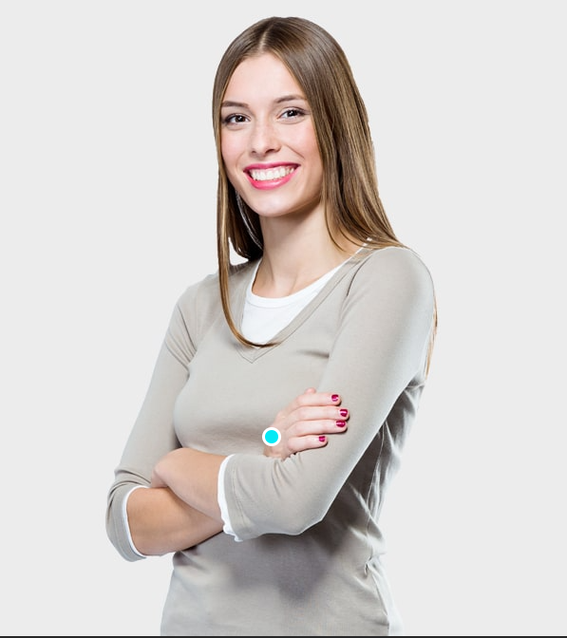
Persona 2
Name: Maria Rodríguez
Background:
Graduate Biological Engineering Student @ IIT
Commuter
Research assistant @ IIT. Working part-time as a nanny.
Demographics:
Age: 23
Goal: Ensure a place to sit while waiting between classes.
How we can help :
Provide a platform that allows students to book study spaces on campus
Real-time update of the occupancy of the seats or study room
Provide online booking function
Optional: Seats can be automatically allocated according to management needs

Slide 5
Industry Examples for your information Note: you do not have to go into this much detail

Slide 6





Sample Role Titles by Industry (Role-based Segmentation)
Class | General | Manufacturing | Financial Services | Public Sector | Retail | Communications
All Star | CxO Department head Board of directors Business unit heads | Mobile specialist | Head of retail banking
Tech Realist | Project manager Team head Marketing specialist R&D | Field engineer Production Technician | Auditors Stock trader Investment advisor M&A | Regulatory authorities Agencies |  | In-house consultant
Deskbound Contributor | Accounting Controller HR specialist Legal officer | Scientist Back Office | Analyst Accountant |  | R&D
Road Warrior | Account Manager Sales Representative Field Engineer Business Development | Field sales | Branch worker Loan advisor Stock advisor
Generalist | Assistant Tele-sales Call center | Field operator Production Operator Call center agent | Call center agent |  | Tele-sales Shop floor roles | Customer services
Notes:
This shows sample role titles by industry. Use this slide to discuss what specific roles your customer has in their organization based on their industry.

Slide 7



Meet John, a Sales Executive
Available in your
RESPONSIBILITIES
CHALLENGES
“Getting new clients is what I’m all about”.
Knowing what going on within geographic area
Tracking the overall market
Locating potential new customers
Creating proposals
Determining margins
Brainstorming with colleagues on best possible solution
Most customer information is only available while I’m in the office
Working with a remote team can be challenging
I need order history when I’m with the customer
Creating meaningful reports is hard
I wish I could blend internal & public information easily
Sales Executive
List the Persona business responsibilities
List the Person’s challenges as related to IT capabilities
Mobile 60% of the time He represents 8% of the workforce
John finds new customers in complex sales departments. Once the deal is closed, he hands the customer over to Linda, who ensures that the order is fulfilled and handles all future issues, including up selling.
WORKSTYLE
NEED & WANTS
Internal Mobility
I live by my phone
I need to work on proposals with remote team members
I need access to our CRM from anywhere
I need a device that’s able to connect to my email and documents no matter where I am
I want all my communications to go through my email, regardless of the original channel
External Mobility
Internal Collaboration
Quick Persona overview with photo, motto, percentage distribution and short overview
External Collaboration
Place Dependency
Work style based on functional needs
What does the Persona need to accomplish responsibilities?
Notes:
Walk through components of a persona.

Slide 8















John’s Workstyle
Available in your
Describe a day in the Persona’s life highlighting specific activities that are typical for the Persona’s work style. This is a very powerful because easy to understand tool.
A DAY IN A LIFE
Preps team for customer meeting.
Starts working on the minutes of yesterday’s customer meeting.
Discuss contract for ABC bank with procurement.
Telephone conference with some colleagues from Europe to discuss ABC bank next steps.
Discuss new product with Peter over lunch.
Look up some sales report figures from her notebook on a corporate SharePoint site.
Confer with Andrew on private cloud solution for XYG Co. via Lync.
Saves the PPT deck to be shown tomorrow to the customer on an encrypted USB stick.
Travel out to meet customer on-site.
Pulls in a SME during the customer meeting with Lync to answer specific customer questions.
“Getting new clients is what I’m all about”.
7:30am
9:00am
12:00pm
2:00pm
5:00pm
Sales Executive
What are the key capabilities that will support needs of the Persona?
CAPABILITY NEEDS
Document Creation
What are the Persona’s current IT-related needs?
Real-time Communication
DEVICE NEEDS
Collaboration
Current Technology
Finding Information & People
LOB Applications
Desired Future Technology
Reporting & Analytics
Compare the Persona’s current device usage to what you envision it to be
Mobility
Notes:
Walk through components of a persona.

